Slide 1



Automated Venipuncture Device
Re-imagining blood collection through robotic precision, computervision and
modular design to eliminate trial-and-error punctures and enhance patient safety.

Slide 2

The Challenge
Manual Blood Draws: A Problem of
Precision
Manual venipuncture remains fraught with complications. Multiple failed
attempts cause patient discomfort, anxiety, and increased infection risk. The challenge intensifies for vulnerable populations for infants, elderly patients, pregnant women, and individuals with darker or low-visibility skin tones where vein detection becomes exponentially more difficult. Each puncture attempt strains the trust between patient and clinician.
The core insight: precision and trust are inseparable in clinical care.

Slide 3
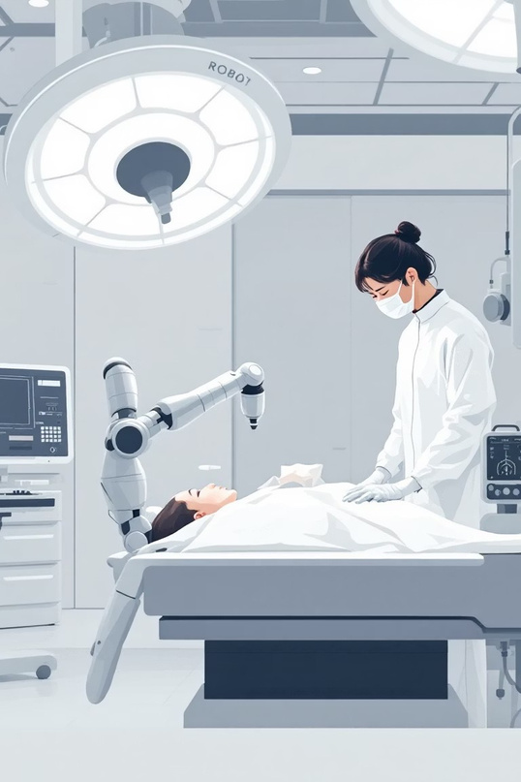
Our Vision
We are building a smart, modular robotic system that automatically identifies
suitable veins, aligns with surgical precision, and performs venipuncture with minimal human intervention for while simultaneously enabling efficient blood sample collection through a modular, adaptable architecture.
Precision
Safety
Eliminate guesswork with computer vision
Reduce failed attempts and complications
Automation
Transform trial-and-error into reliable process

Slide 4
Five-Step System Architecture
01
Wearable NIR Belt
02
Real-Time Processing
03
Precision Alignment
Infrared imaging captures high-contrast vein visualization across all skin tones.
Raspberry Pi analyzes image, maps vein geometry, computes optimal puncture coordinates.
SO100ARM six-axis robotic arm positions
needle with micrometer accuracy.
04
Controlled Puncture
05
Smooth Extraction
Piezoelectric actuator penetrates skin to exact depth for 2-3mm precision.
Micro vacuum pumping enables gentle, consistent blood collection.

Slide 5

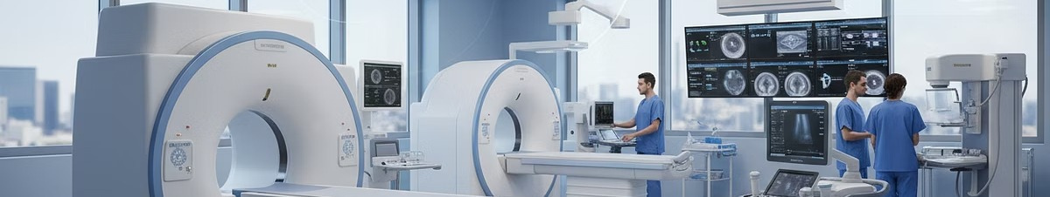
Layered System Intelligence
Sensing Layer
Control Layer
ð
Wearable NIR belt with infrared LEDs and camera captures stable, high-contrast vein imagery. Anti-shake elastic mount
ñ
SO100ARM robotic arm executes inverse kinematics solving via
CCD method. Motor commands transmit via Arduino and servo
ensurespatientcomfort during imaging.
drivers for perfectly aligned tip positioning.
Processing Layer
Actuation Layer
ñ
Raspberry Pi runs advanced image preprocessing: grayscale conversion, CLAHE enhancement, top-hat filtering, vein skeletonization. System identifies longest continuous vein and selects optimal puncture point (cx, cy).
ô
Modularend-effectors: piezoelectric puncture head for precise 2-
3mm depth control and suction head with mini vacuum pump for
consistent blood extraction.

Slide 6

Hardware Components
6-DOF SO100ARM
Raspberry Pi 4B
Industrial-grade robotic arm engineered for medical precision and repeatability.
Real-time controller processing vision data and executing
motor commands.
NIR Imaging Module
Piezoelectric Actuator
Infrared camera and LEDs for vein detection across all skin tones.
Precision depth control for safe, accurate skin penetration.
Micro Vacuum Pump
3D-Printed Mount
Gentle, consistent blood collection with pressure monitoring.
Lightweight, modular syringe attachment system for adaptability.

Slide 7

Software Intelligence Stack
Core Modules
We don't guess the vein for we compute it with mathematical precision.
Image Acquisition & Enhancement: Real-time NIR preprocessing with
advanced filtering
Vein Detection: Automated identification and optimal puncture point
selection
Robotic Alignment: Inverse kinematics computation and trajectory planning
Sequence Control: Coordinated puncture initiation and suction extraction
Technology Foundation
Python · OpenCV · NumPy · PySerial

Slide 8
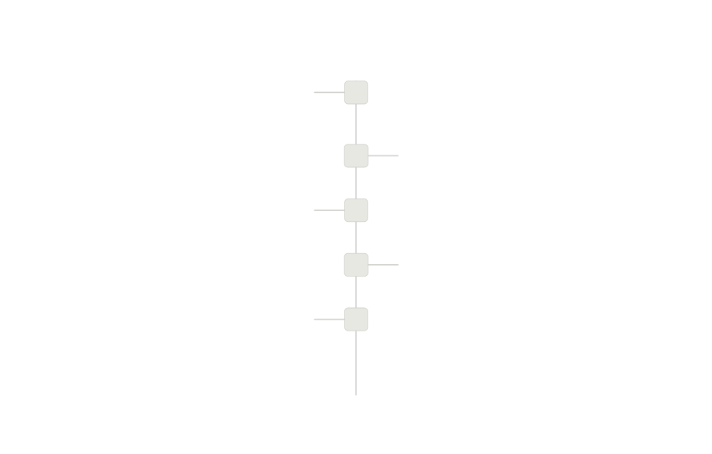
Integrated Workflow Demonstration
1
Capture
Wearable belt acquires vein image
2
Process
Pi analyzes and maps coordinates
3
Align
Robot positions with precision
4
Puncture
Piezoactuates at exact depth
Extract
5
Vacuum pump collects sample
End-to-end workflow: sensing through actuation, unified by real-time algorithmic control and modular hardware design.

Slide 9

Innovation Breakthrough
Modular Architecture
Vision-Robotics Integration
CCD-Based Kinematics
Dual-attachment end-effectors enable seamless transitions between puncture and collection tasks.
Computer vision directly controls robotic motion for closing the feedback loop between seeing and acting.
Cyclic Coordinate Descentinverse
kinematics delivers human-like precision motion planning.
Piezoelectric Precision
Simulation-Ready Design
Micro-scale depth control (2-3mm) eliminates complications from over- or under-penetration.
Fully modeled and validated before
hardware deployment for reducing clinical risk and accelerating adoption.

Slide 10

Future Clinical Expansion
MachineLearningIntegration
Autonomous vein classification and adaptive puncture strategy
refinement through clinical datasets.
Depth Sensing Enhancement
Integrated tactile sensors provide real-time feedback for safer,
more confident puncture decisions.
Portable Wireless Platform
Battery-powered, wireless-enabled version extends access to
rural clinics and resource-limited settings.
Surgical Expansion
Adaptable architecture enables deployment in ENT and
specialized surgical procedures requiring precision vascular access.

Slide 11
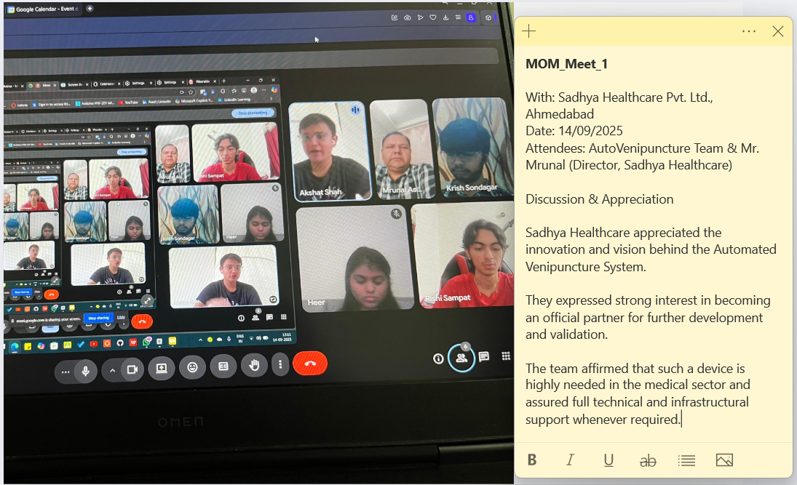

Slide 12
